Slide 1
Utility-Scale Solar
The Power Solution that Doesn’t Solve a Grid Power Problem

Slide 2
Utility-Scale Solar – Is It a Solution?
Does utility-scale solar solve a power problem in TVA?
Is utility-scale solar a necessary part of the TVA grid?
We’ll look at TVA production data from the US Energy Information Administration
  July 2025 all power production versus utility-scale solar data
  January 2026 all power production versus utility-scale solar data, including winter storm Fern
  Solar production during rolling outages between December 26th 2021 and January 2nd 2022
  TVA total demand for July 2025 and January 2026
  The US Map of Power Authorities
  The CAISO “Duck Curve” and solar power curtailment in CA
  The TVA Duck Curve, Natural Gas curtailment
  The MISO Duck Curve, Natural Gas curtailment
  Look at US, MISO and ERCO data from April, renewable vs conventional power generation
  Do a deep dive on power production and utilization during winter storm Fern, January 2026
  Conclude by looking at the problem utility-scale solar does solve

Slide 3
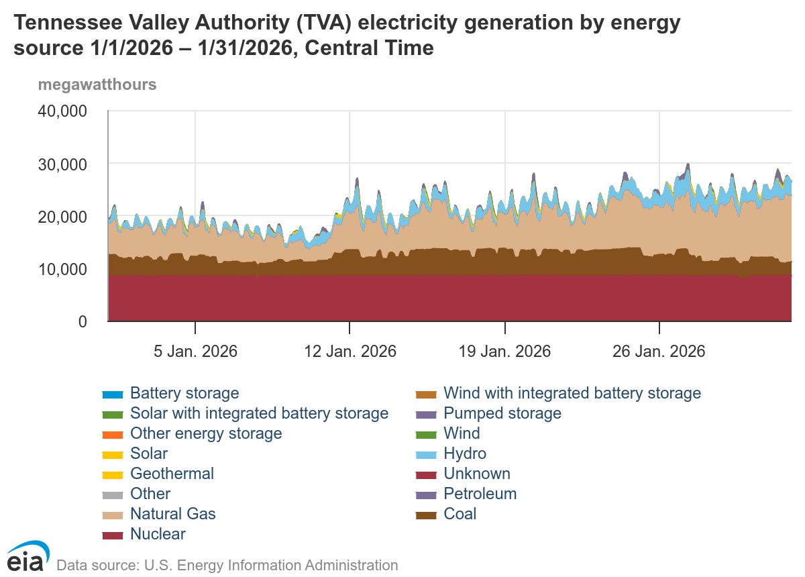
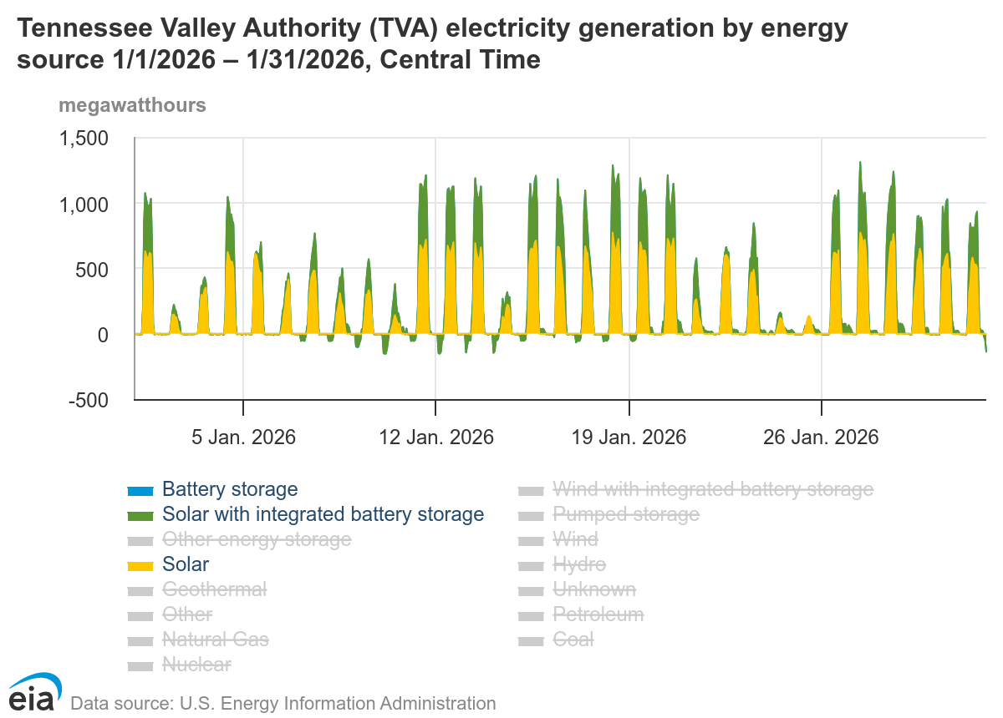
Utility-Scale Solar – TVA Production History
Fern
For all of January 2026, peak solar production is sketchy at best! During winter storm Fern, solar production was close to nil.
Notes:
The charts are directly from the US EIA grid production dashboard.
The chart on the left is of the full production picture at TVA for January 2026.
The chart on the right is only utility-scale solar and utility-scale solar with BESS.
Note that solar production is sketchy at best. Very inconsistent and during winter store Fern, solar production as near zero.
Consistency is the main issue with utility-scale solar.

Slide 4
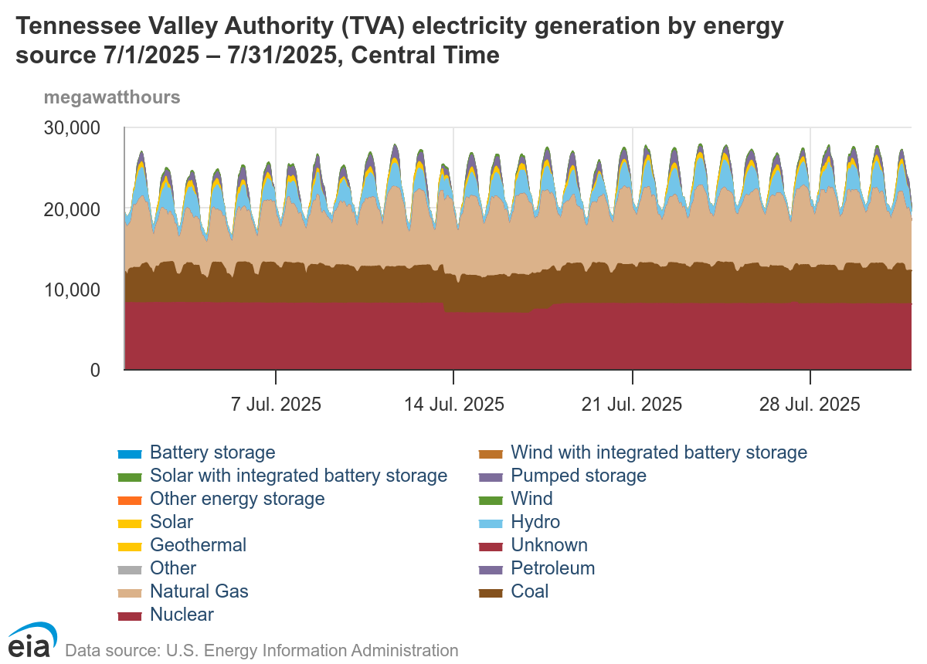
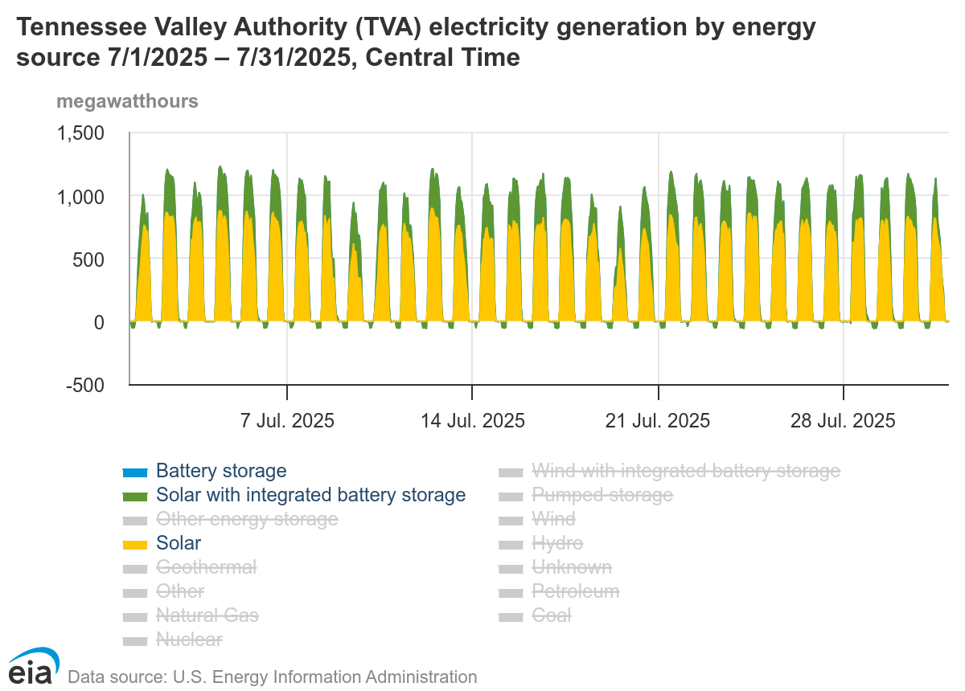
Utility-Scale Solar – TVA Production History
Notes:
These charts are directly from the US EIA grid production dashboard.
This set of charts represents July 2025. While utility-scale solar production was better than January, it is still rather inconsistent.

Slide 5
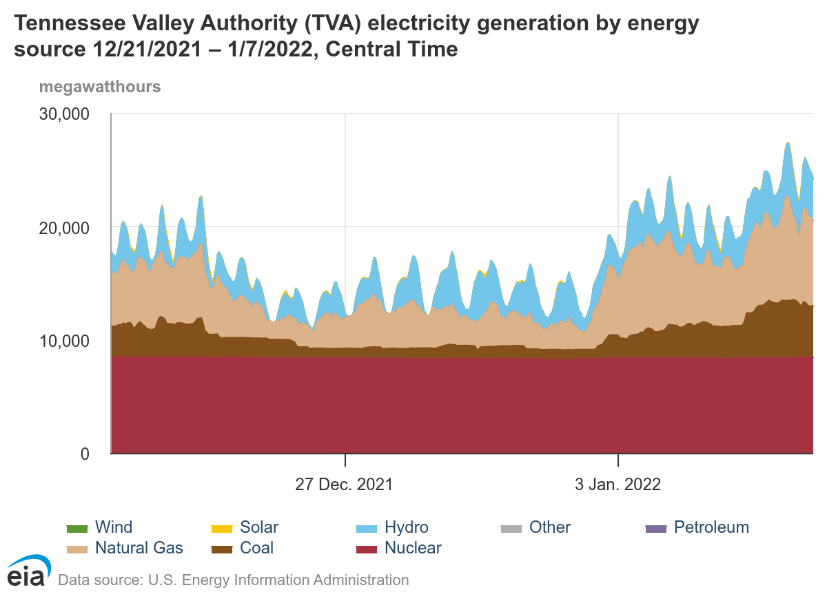
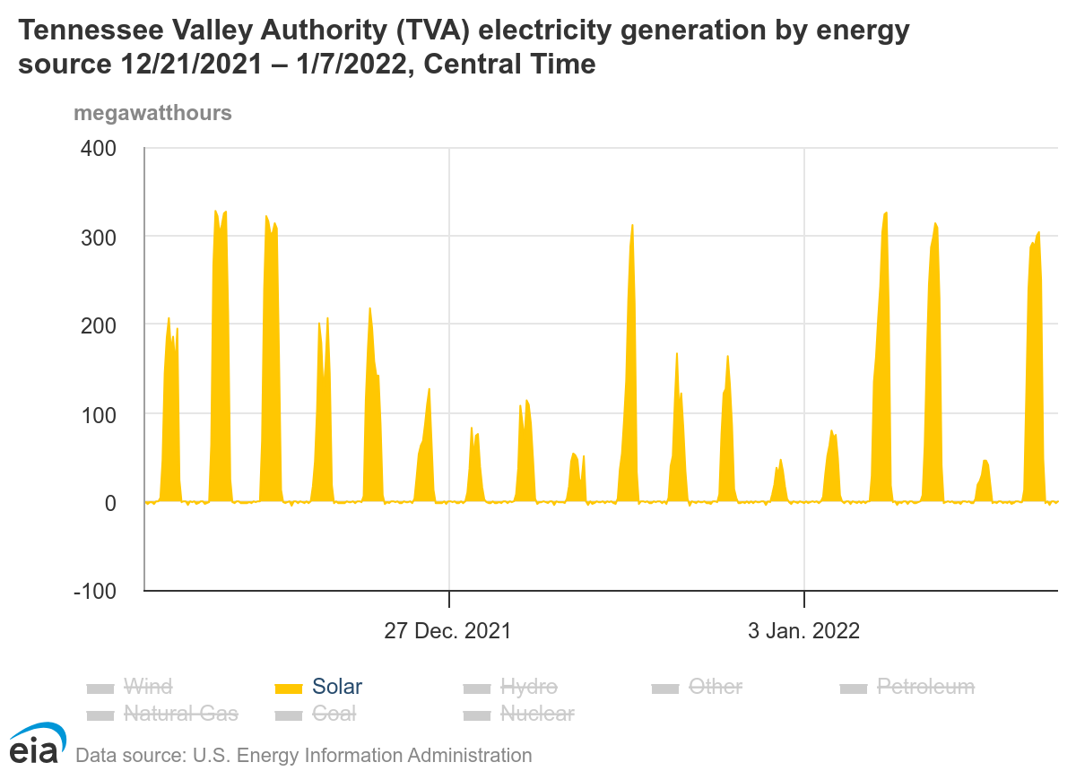
Utility-Scale Solar – TVA Production History
During the power outage Solar only had 1 day that peaked above 300 MWh!
Notes:
These charts are directly from the US EIA grid production dashboard.
This chart is when the Cumberland Coal Plant failed resulting in rolling outages. Note that utility-scale solar was not help at all.

Slide 6

Utility-Scale Solar – TVA Total Power Demand
This chart contrasts July 2025 with January 2026.
The difference between maximum and minimum demand in July 2025 was relatively constant at between 5,000 MWh and 5,500 Mwh. However, the difference between maximum and minimum demand in January 2026 was significant reaching a maximum difference of 17,121 MWh.
→January 2026 reached a higher peak than July 2025, reaching a maximum demand of 32,685 MWh vs the July 2025 max of 31,657 MWh.
The Peak, Shoulder, and Off-Peak hours are different between Summer and Winter. Solar impacts Summer Shoulder and Peak hours.
17,000 MWh max
Notes:
These charts are from a download of csv data from the US EIA grid production dashboard. They were loaded into a postgesql database and the weekday hourly min/max was generated using sql.
These charts are the weekday hourly minimum and maximum values for July 2025 and January 2026.
Note that the peak demand in July 2026 was 31,657 and the peak demand in January 2026 was 32,685.
We’ll look at this in more depth later.

Slide 7
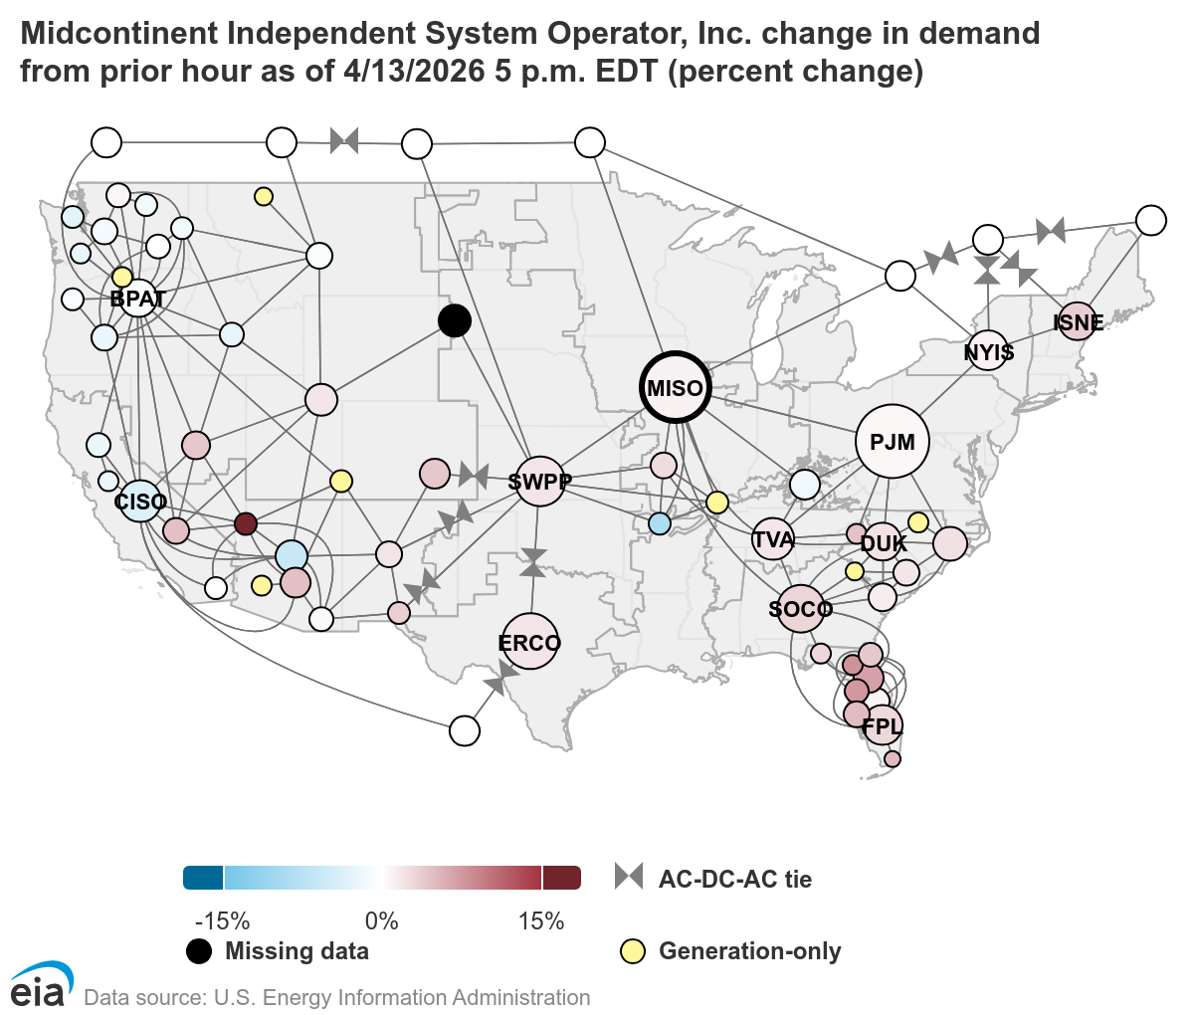
Utility-Scale Solar – MISO / TVA
Another power authority in the US is the Midcontinent Independent System Operator (MISO), which has a significant solar/wind generation capacity.
We’ll look at some recent MISO data and data from the same timeframe from TVA.
We’ll explore the “Duck Curve” for both TVA and MISO.
Notes:
This is a US map of the various Power authorities/operators directly from the US EIA grid power dashboard.

Slide 8
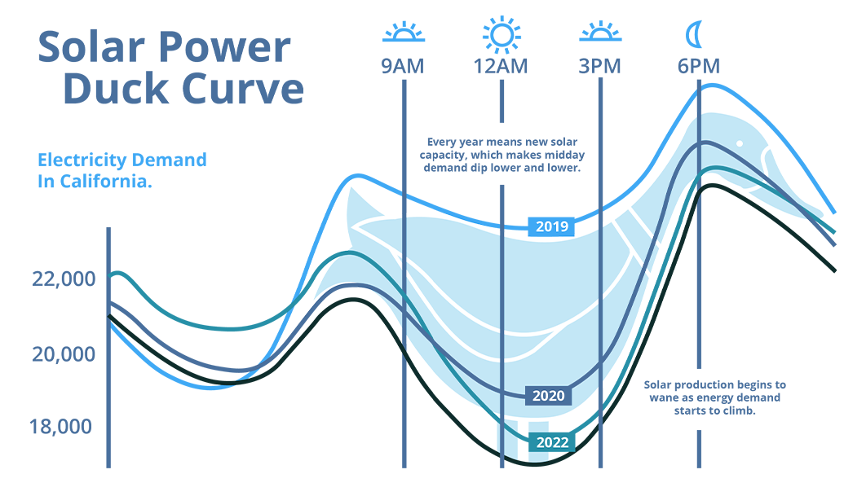
Utility-Scale Solar – The Duck Curve/Curtailment
The term “Duck Curve" was coined by the California Independent System Operator (CAISO) in 2012, based on a graph that visually resembles a duck. This graph illustrates the timing imbalance between electricity demand and solar power generation throughout the day.
In other words, this means that no matter how much utility-scale solar is installed, the requirement for other more reliable sources of power are still needed to meet demand.
Today, CA has installed so much utility-scale solar that solar production must be curtailed to manage transmission line stability.
Notes:
The picture is a download of the CAISO duck curve and the chart is produced from CAISO data downloaded to excel.
The key thing to point out on this slide is the fact that back in 2012 the CAISO knew there was a problem with solar power not meeting peak demands.
There is a clear timing imbalance between solar production and demand for electricity. We’ll see in a subsequent set of charts that this applies to renewables in general.
The Curtailment is a result of installing so much wind and solar that when renewables are all production, not all of the power can be applied to the grid, hence the term curtailment.

Slide 9
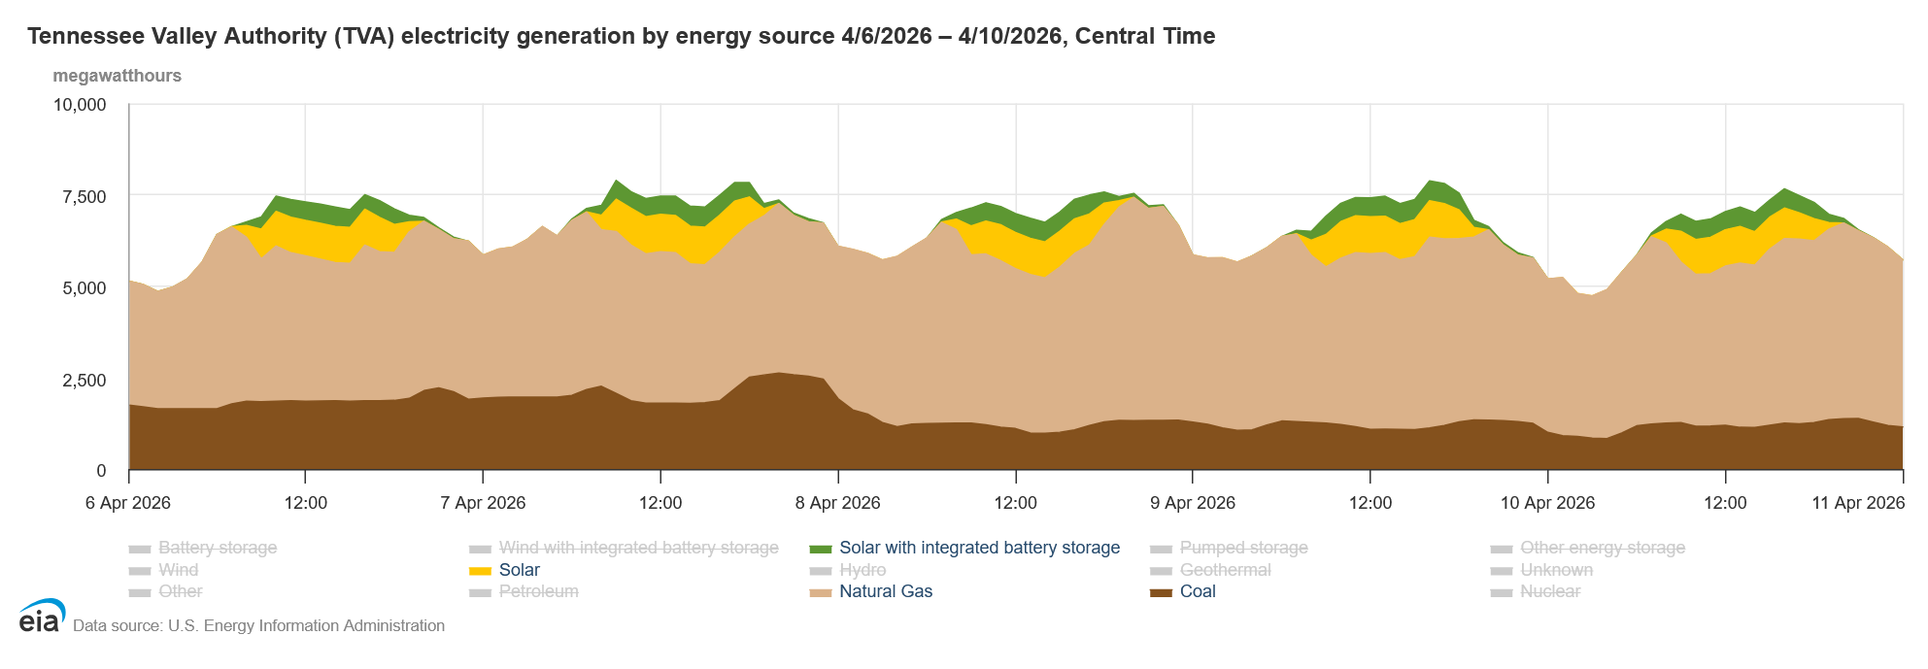

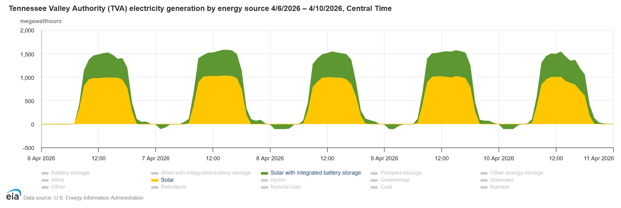
Utility-Scale Solar – The Duck Curve at TVA
TVA does have a Duck Curve, albeit a small one.
There is not Wind or Wind/Bess in TVA, only Solar and Solar/BESS.
The thing to notice here is what happens as solar ramps up. NatGas is “curtailed” as solar ramps up.
Also, as solar production decreases, both Coal and NatGas production increase.
BESS is charging when the green drops below Zero.
The Duck Curve forces higher cost for conventional generation because it causes curtailment of conventional production during peak and shoulder pricing hours.
Notes:
These charts are directly from the US EIA grid production dashboard.
There is actually a duck curve in TVA, though it is a small one. Here, as in several other slides, we’ll compare renewable to fossil fuel power generation.
Note that as utility-scale solar ramps up, natural gas and coal power is curtailed, though it is really a matter of scaling up and down, it has the same effect. The full capacity of coal and natural gas power is not realized, therefore I consider it curtailed.
Note that the utility-scale solar with BESS actually drops below the zero line. This is when the batteries are being charged.
Also, particularly during the summer, utility-scale solar tends to peak during shoulder to peak pricing hours. This takes the highest priced production away from natural gas and coal production, thus potentially resulting in higher prices for natural gas and coal power.

Slide 10
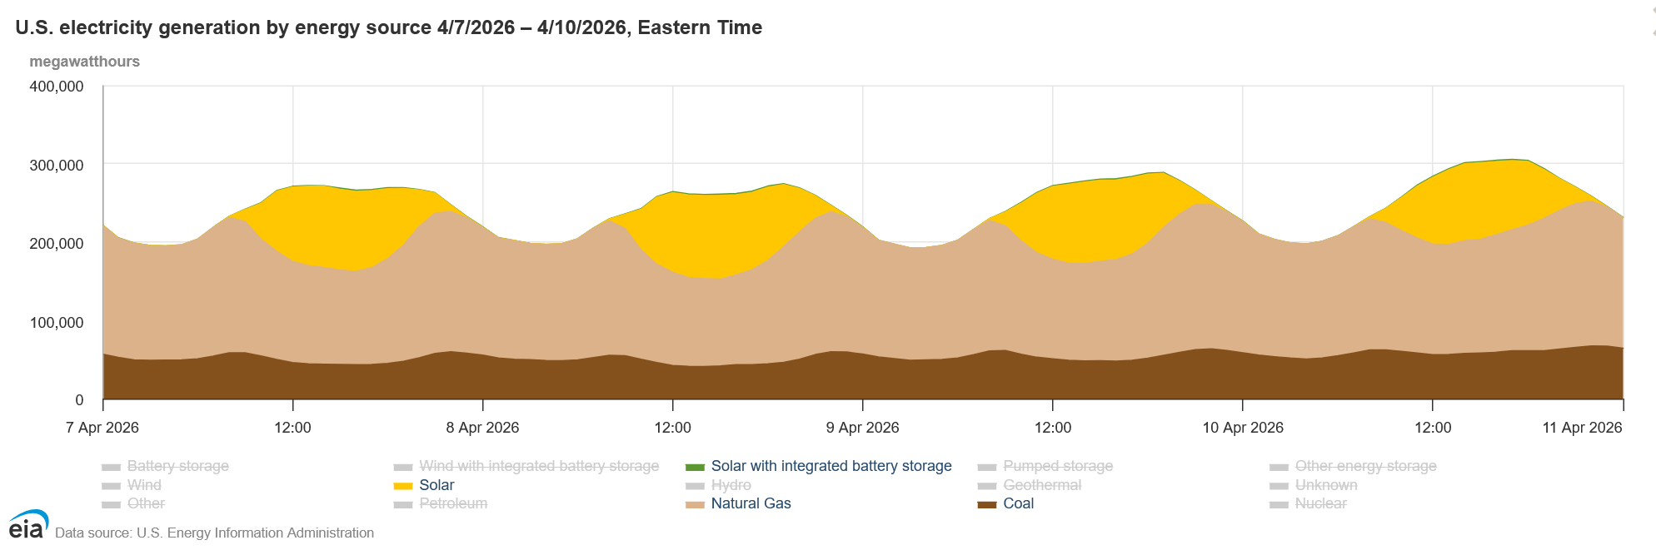
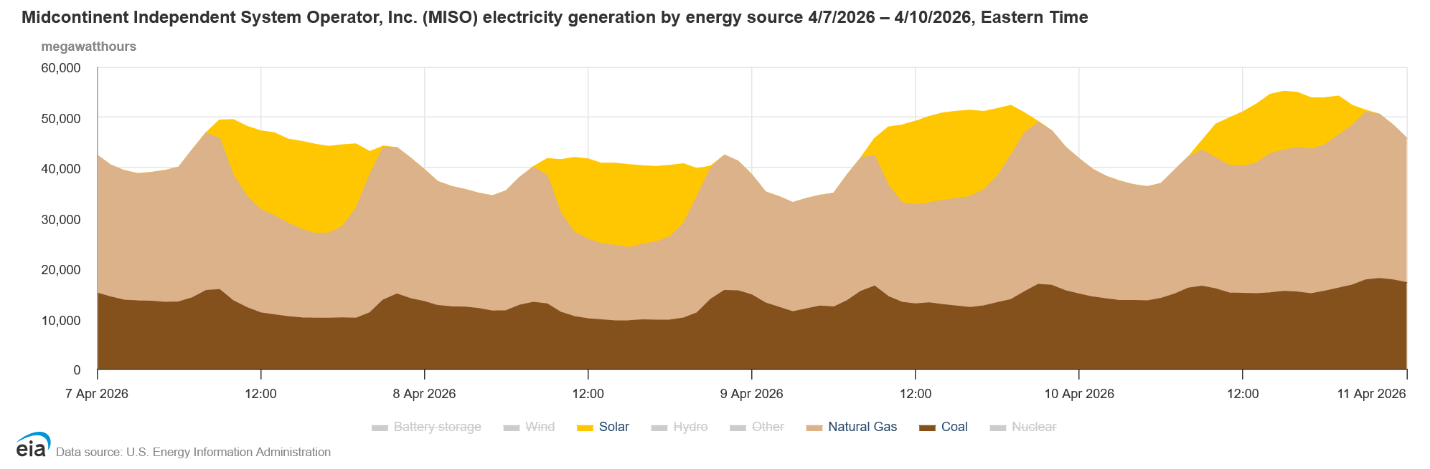
Utility-Scale Solar – The Duck Curve at MISO
The total production across the US clearly shows the Duck Curve. Power is shown in megawatt hours produced. As solar ramps up, Natural Gas and Coal are curtailed.
MISO also has a significant “Duck Curve.”
The effect of the Duck Curve as solar ramps up. NatGas and Coal is curtailed as solar ramps up.
Also, as solar production decreases, both Coal and NatGas production increase.
Once again, renewables consume PEAK hours which forces cost for conventional generation to be more expensive.
Notes:
Looking at the US data for solar versus fossil fuel production. Note the Duck curve is more distinct and natural gas and coal power is scaled back (curtailed) to a much greater degree. The same is true of MISO.

Slide 11
Utility-Scale Solar – MISO/ERCO Generation
The two charts on the right demonstrate the
“Duck Curve” in action. As you can see, when renewables produce more, conventional generation is curtailed and as renewables drop off, conventional generation makes up the difference. Power is shown in percentage of generation by producer.
Nuclear, hydro, and other producers are not shown in order to highlight the difference between conventional and renewable power generation.
Notice MISO, on April 10th,and ERCO on April 6th, that conventional generation had to provide most of the energy.
The “Duck Curve” is shown in both charts to highlight the difference between power demand and the ability of renewables to meet the demand.
The key takeaway is that both MISO and ERCO have the same issue as TVA. They must be able to provide the majority of the power demand using Coal and Natural Gas.
Notes:
These charts were produced from csv data downloaded from the US EIA grid production dashboard into excel.
Here you can see a comparison of percent generation as opposed to megawatts produced all renewables versus all fossil fuel production. These charts absolutely demonstrate the inconsistency and unreliable production characteristics of renewable energy.
MISO has nearly 55,000 MW of renewables installed, but note that around 9 PM on April 10th that fossil fuel sources were generating 94% of the power. Renewables were only producing 6% of the power. With nearly 55,000 MW “capacity” MISO only realized less than 3,400 MW of production.
ERCO was just about as bad. Having more than 75,000 MW of renewables installed, at 8 AM on April 6th, 82% of the generation was from fossil fuel sources. With more than 75,000 MW of “capacity” ERCO only had 6,700 MW of renewable power production.
The takeaway from this is that no matter how much renewable production is installed, there must be enough fossil fuel, hydro or nuclear poer sources to meet the full demand. Renewable energy does not keep power companies from the need to meet all capacity with conventional power generation.

Slide 12
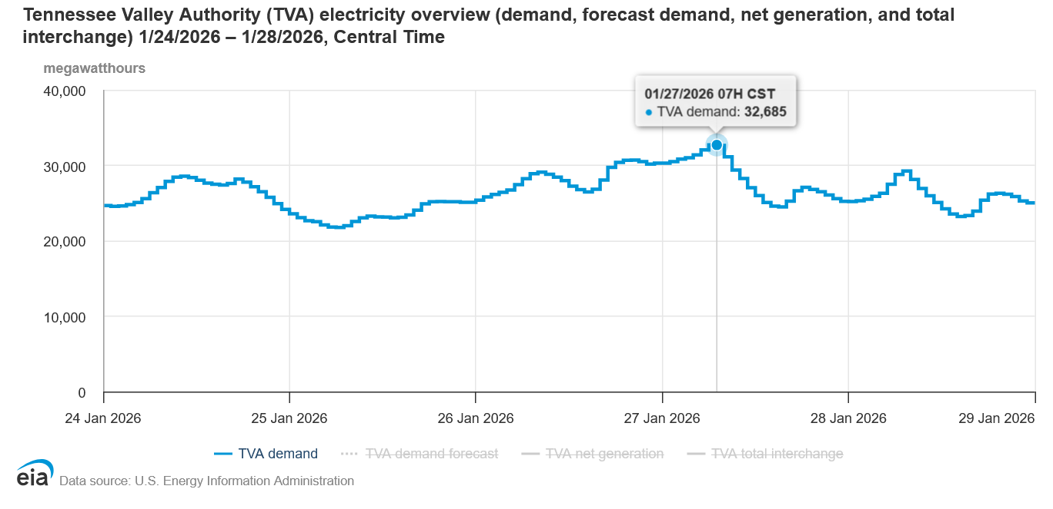
Utility-Scale Solar – TVA Production During FERN
This chart tells the whole story, a sort of coup de grâce.
It shows that no matter how much utility-scale solar is installed, TVA still needs 100% conventional power generation capacity to meet the power demand. Power is shown in percentage of production by power generation source, excluding all sources but renewable and conventional power generation.
Peak demand was 32,685. Net generation was 29,774.
This means TVA had to secure additional power from neighboring authorities to satisfy demand.
01/27/2026, 7 A.M. Central Time
Solar with BESS was using 2 MWh
Solar was producing 0 MWh
Date | 01/25/26
Time | 11:00 | 12:00 | 13:00 | 14:00 | 15:00
solar_bess_mwh | -38 | -65 | -77 | -80 | -51
solar_mwh | 75 | 112 | 135 | 128 | 103
natgas_mwh | 9026 | 8826 | 8954 | 8910 | 8964
coal_mwh | 3653 | 3614 | 3559 | 3565 | 3542
Date | 1/27/2026
Time | 7:00
solar_bess_mwh | -2
solar_mwh | 0
natgas_mwh | 11211
coal_mwh | 4827
Notes:
The chart on the left is directly from the US EIA grid production dashboard. The chart on the right was produced from csv data downloaded from the US EIA grid production dashboard into excel. The tables are excel transpositions excerpts from that CSV data.
This slide is the most important slide. Here we see demand or 32,685 at 7 AM on January 27th. Looking at fossil fuel versus renewable percentage generation, at 7 AM on January 27th, utility-scale solar was producing 0 MW and utility-scale solar was drawing 2 MW.
Where the percentage dropped below 100%, utility-scale solar was charging at a significant rate.
This is clear evidence that, no matter how utility-scale solar, utility-scale solar with BESS, and wind renewables are installed, there must be either fossil fuel, nuclear, or other power generation sources that are reliable and consistent.

Slide 13
Utility-Scale Solar – The ESG Conclusion
Utility-Scale Solar & ESG
ESG stands for Environmental, Social, and Governance. In essence in means achieving NetZero, DEI, and how well a company manages its accountability & transparency as well as it’s NetZero and DEI goals.
NetZero is where utility-scale solar comes in. Note the “Net” in NetZero. This actually means that companies can buy credit for renewable energy to reach a “Net” balance of “Zero” CO2 emissions. So, while solar doesn’t really solve a power problem, it does provide the ability for companies to obtain credit for renewable energy, thus offsetting their use of energy produced by fossil fuels.
Companies like Google, Meta, Microsoft, and Apple need credit for green energy to offset their use of power generated by fossil fuels. To do this Renewable Energy Certificates (RECs) were created in states that have Renewable Portfolio Standards (RPS). TVA manages the grid for a number of states that don’t have RPS, so TVA created a program called Green Invest. This program allows companies to buy 200KWh blocks of green energy “credit” for $3.25 per block. A minimum purchase of 2 MWhs costs $32.5.
To understand what this means for utility-scale solar, we need to understand how much energy is produced by the solar infrastructure. On average, 1 MW of solar generation creates 2146 MWh per year. This equates to $34,872.50 per MW of solar infrastructure. So, a 100 MW facility would theoretically generate $3,487,250 in Green Invest revenue each year. Typically, green energy credit counts as renewable energy even if the power is not used as long as the generation is certified. The curtailed energy in CAISO would still generate RECs if the power is certified as produced, whether or not that power is used.
Notes:
The real problem solved by renewable energy actually has nothing to do with energy production. While solar companies want to rake in profits by stealing peak and shoulder pricing hours from conventional production sources, renewable energy also creates RECs ( in various forms).
ESG is a sick and twisted model that is pushed by the UN and WEF. In TVA RECs as sold as “Green Invest” blocks.

Slide 14
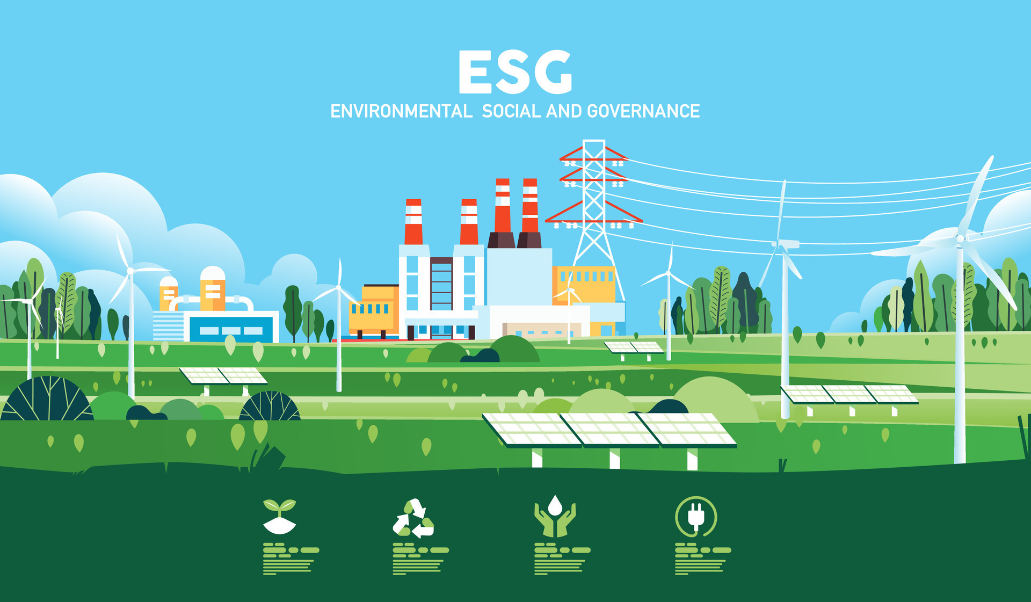
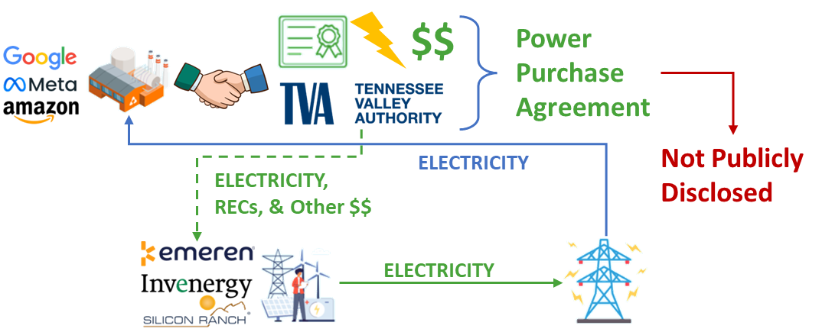

Utility-Scale Solar – The ESG Conclusion
So how are these ESG deals done. In TVA companies enter into a Power Purchase Agreement (PPA) where they contract to buy a certain amount of power and they also purchase the rights to renewable energy. This is exactly what Google did with the Yum Yum solar project. The bottom line that companies like Google want renewable energy installed so they can use those MWh as offsets to get to NetZero.
In February 2026, the TVA board voted to drop the renewable goals, DEI, and also voted to keep the coal-fired power plants open beyond 2028. This has interesting implications with regard to future PPAs for renewable energy.
Notes:
In TVA, PPAs are proprietary agreements that include the purchase of power, credit for renewable energy, direction investments and other things. These agreements are not disclosed to the public, even though TVA is a government organization. These PPA agreements should be public record as they directly affect public interests.

Slide 15
Utility-Scale Solar – Summary and Links
Based on the US EIA data, it should be clear that Utility-Scale Solar is not a necessary contributor to TVA production!
If utility-scale solar isn’t a necessary contributor to the power grid, what problem does it solve?
Who benefits from utility-scale solar power?
https://www.eia.gov/electricity/gridmonitor/dashboard
https://cleanview.co/solar-farms/us
https://cleanview.co/wind-farms/us

